Slide 1
WEB TECHNOLOGY
Portfolio
WEBSITE
by RAJA RAJESWARI [22IT072]
NIVASSHINI [22IT063]
RAJA THAARANI [22IT073]
https://nealwuportfolio.netlify.app/

Slide 2
PROJECT DEFINITION
welcome to
PORTFOLIO WEBSITE
The portfolio website serves as a dynamic platform to showcase a collection of projects and achievements. Developed using Angular for the frontend and MongoDB for the backend, it features an intuitive and responsive design, enabling visitors to easily explore detailed project descriptions and user experiences. The site efficiently manages user data while ensuring optimal performance and scalability, presenting a comprehensive overview of skills and expertise.
https://nealwuportfolio.netlify.app/
Page 02

Slide 3
table of
CONTENT
ABSTRACT
FEATURES
EXISTING SOLUTIONS
CUSTOMER FEEDBACK
FRONTEND TOOLS
BACKEND TOOLS
portfolio WEBSITE
Page 03

Slide 4
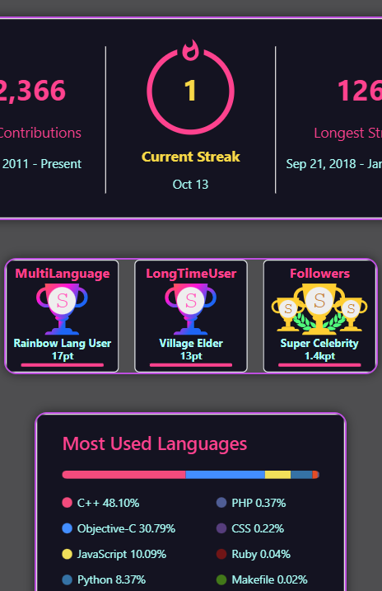
Abstract
The Portfolio Website Project is a dynamic application showcasing personal achievements, skills, and projects through a visually appealing design. Built with AngularJS, Node.js, and MongoDB, it features modular architecture for easy expansion. Key sections include 'About Me,' highlighting personal background, a real-time achievements page with GitHub stats and certifications, a project gallery with interactive previews, and a contact form. Node.js handles user authentication and data management, while MongoDB stores profiles and project details. The site’s modern design and real-time data integration make it ideal for personal branding and networking, offering an engaging experience across devices.
PORTFOLIO WEBSITE

Slide 5
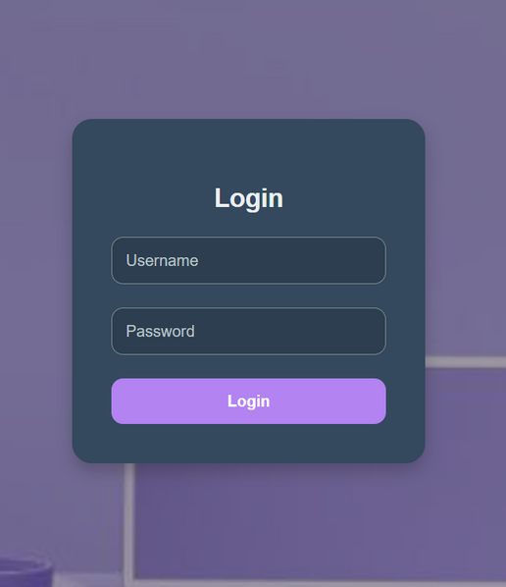
work
FEATURES
About Me: Personal bio with a unique design.
Achievements: Displays real-time GitHub stats and certifications.
Projects Gallery: Showcases projects with descriptions and interactive previews.
Video Gallery: Embeds tutorials and talks from YouTube.
Skills: Visual representation of technical skills.
User Authentication: Secure sign-up, email verification, and password recovery.
Contact Form: Allows visitors to send messages.
Backend Integration: Node.js for data management and MongoDB for storage.
Responsive Design: Optimized for various devices.
Navigation: Easy browsing and filtering options.
EVENT LOGIN
https://nealwuportfolio.netlify.app/
PORTFOLIO WEBSITE

Slide 6
portfolio website
Existing
GitHub Pages: Free hosting for static sites from GitHub repos.
WordPress: Flexible CMS with themes and plugins for customization.
Wix: Drag-and-drop builder for easy, visually appealing sites.
Squarespace: Beautiful templates tailored for portfolios.
Weebly: Simple builder with e-commerce capabilities.
Adobe Portfolio: Customizable sites integrated with Adobe Creative Cloud.
Behance: Platform for showcasing creative work with community feedback.
Figma: Design tool for creating interactive portfolio prototypes.
SOLUTION
https://nealwuportfolio.netlify.app/

Slide 7
PORTFOLIO WEBSITE
CUSTOMER FEEDBACK
PRIMARY
SECONDARY
OTHERS
JOB SCHOLARS
RECRUITERS
FAMILY
The Achievements section is a great addition—it’s helpful to see real-time stats from GitHub and LeetCode, which really showcase the developer's skill and commitment.
I’m impressed with the user-friendly layout and the clean, modern design of this portfolio website! Explains the project work neatly
Exited to see what our wards are working on!!
https://nealwuportfolio.netlify.app/

Slide 8
PORTFOLIO WEBSITE
FRONTEND
BACKEND
Angular
HTML5
CSS3
NODE JS
MANGO DB
EXPRESS
more
more
https://nealwuportfolio.netlify.app/

Slide 9
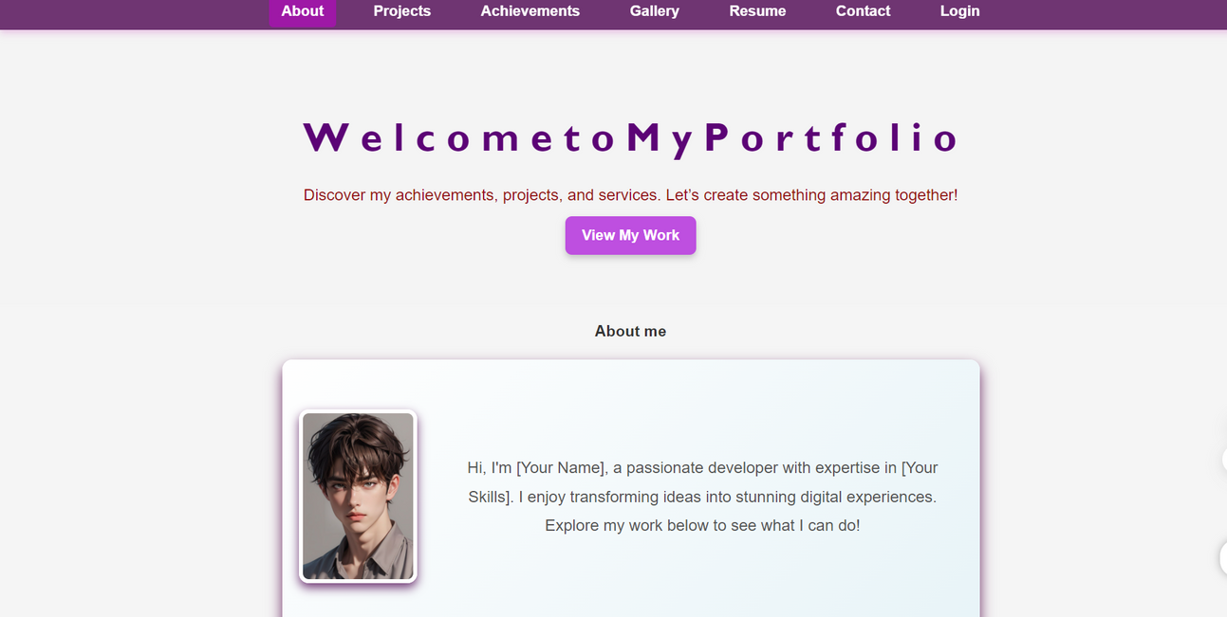
PORTFOLIO WEBSITE
PROJECT SCREENSHOTS
www.reallygreatsite.com
HOME PAGE

Slide 10
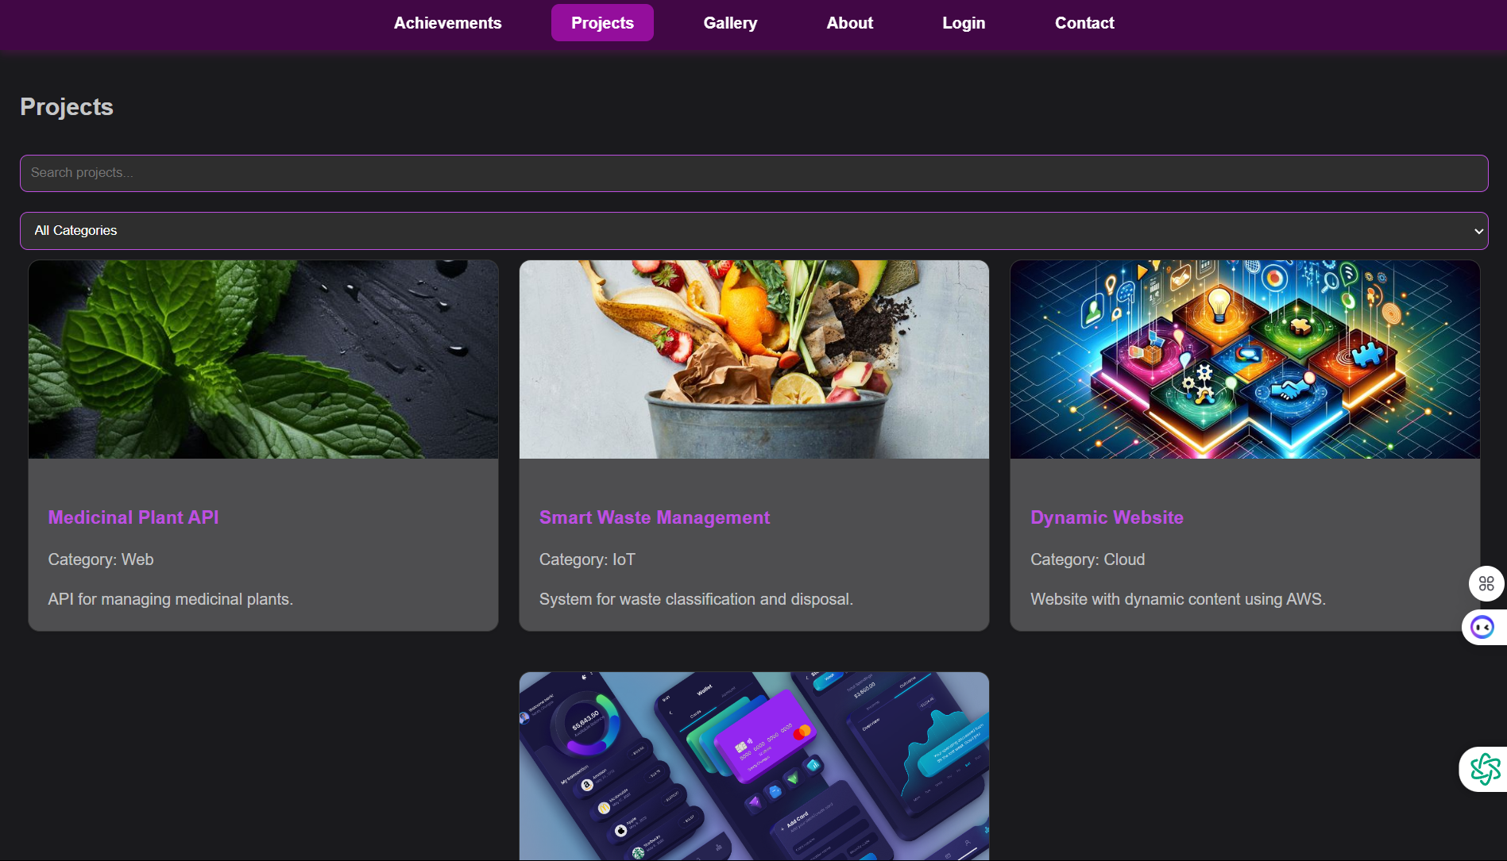
PROJECT SCREENSHOTS
www.reallygreatsite.com
Project page

Slide 11
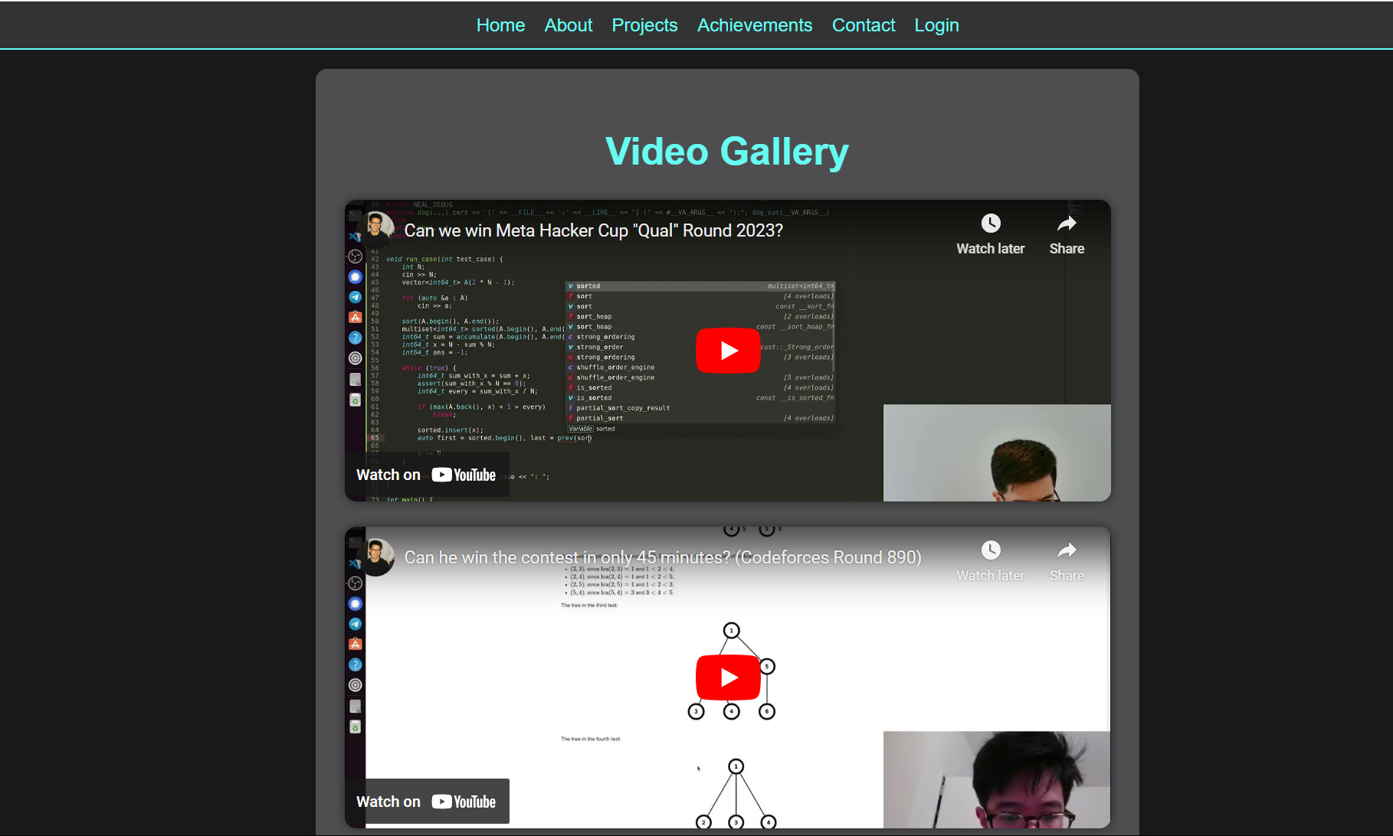
Video gallery

Slide 12
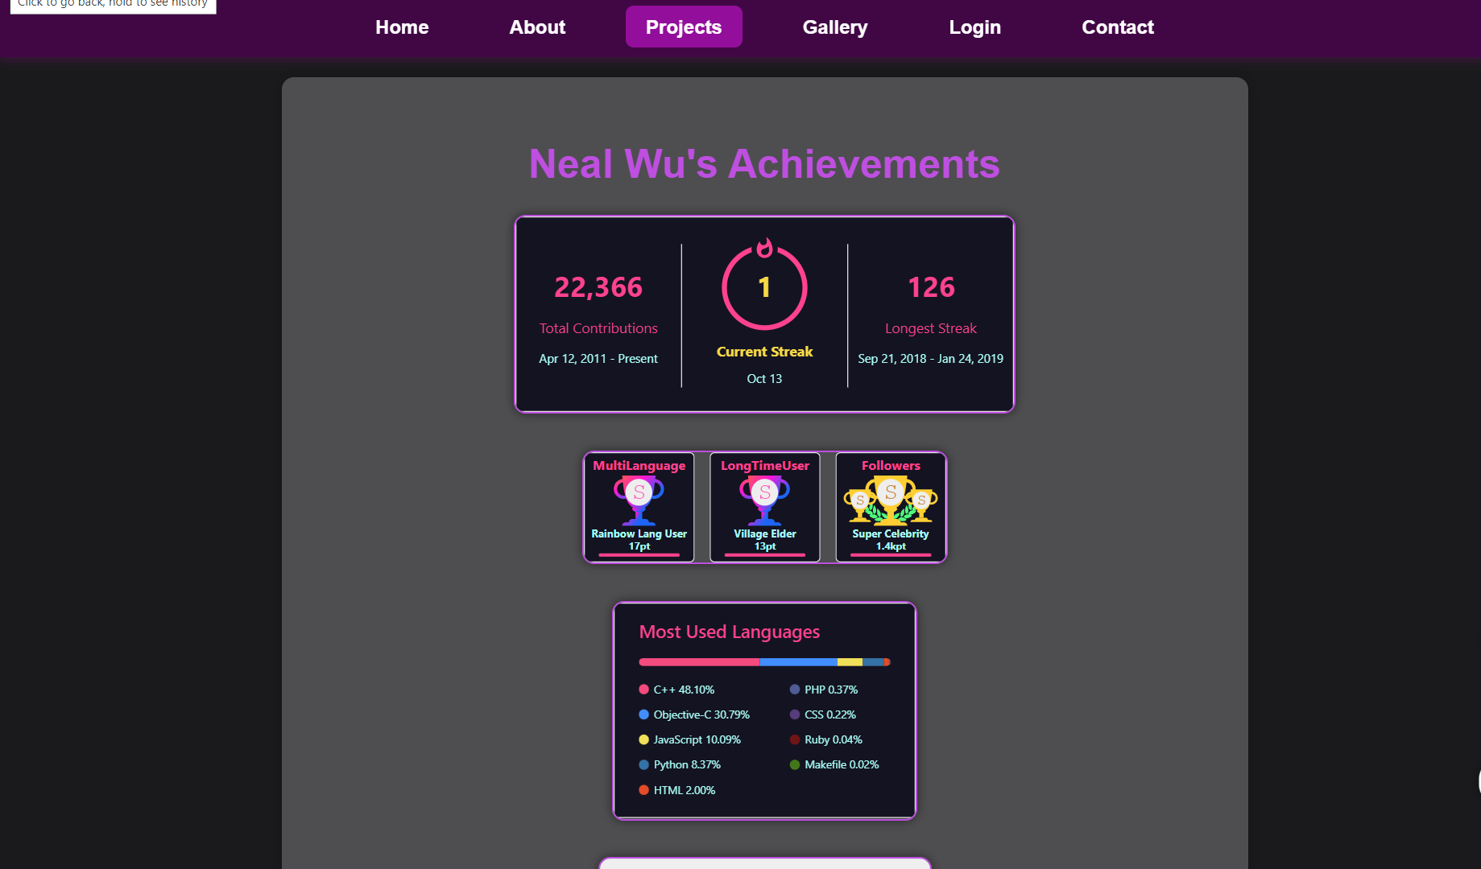
achievements

Slide 13
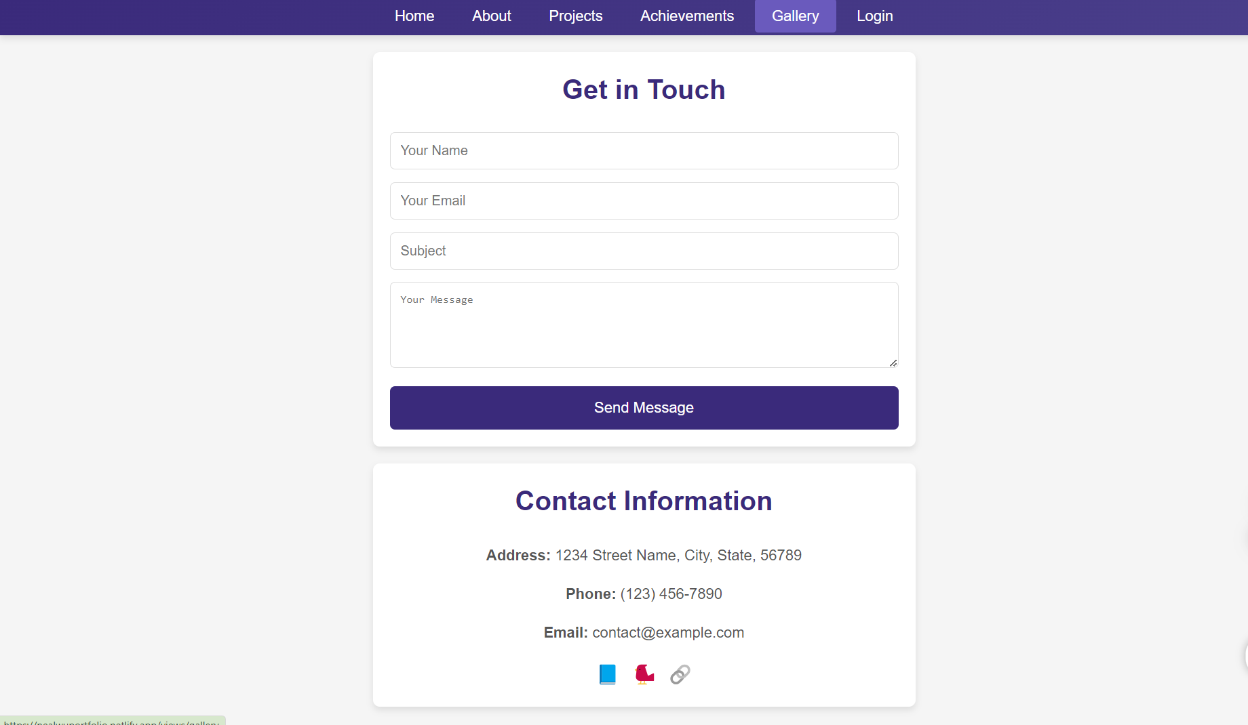
Contact us

Slide 14
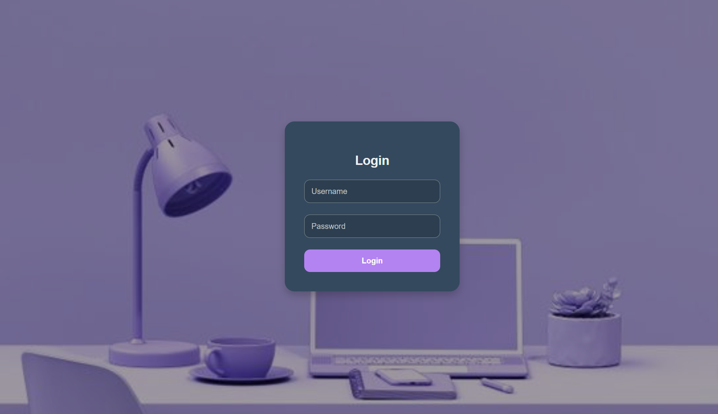
login

Slide 15
PORTFOLIO WEBSITE
Thank
You
https://nealwuportfolio.netlify.app/

